Slide 1
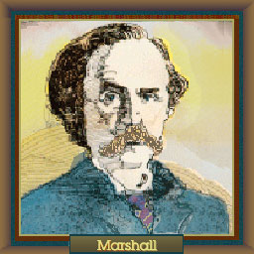
Economics!!
Economics is the study of mankind in the ordinary business of life
--Alfred Marshall

Slide 2
Let’s try an exercise:
[& learn some economic concepts]
Your group is building a new zoo.
You have to decide what animals to have.
Space is limited. You get 25 acres.
Take 8-10 minutes to make your selections, based on the next slide.

Slide 3
Zoo Choices – 25 acres total!
Lion - 2 acres
Turkey - 1/10 acre
Giraffe -1 acre
Seal - 1/2 acre
Camel - 1/2 acre
Cheetah - 1 acre
Cow - 1/3 acre
Monkey - 1/2 acre
Asian Elephant - 1 acre
African Elephant - 1.5 acres
Reptile House - 5 acres
Hammerhead Shark - 1/2 acre
Kangaroo - 1/2 acre
Tiger - 1 acre
Whales - 3 acres
House of Birds - 5 acres
*Numbers are acres required for ONE animal (hint: they don’t like being alone!)
[If you had 2 of each, it would take over 34 acres–so you will have to make choices.]

Slide 4
25 ACRES
Lion - 2 acres; Turkey - 1/10 acre; Giraffe -1 acre; Seal - 1/2 acre; Camel - 1/2 acre;
Cheetah - 1 acre; Cow - 1/3 acre; Monkey - 1/2 acre; Asian Elephant - 1 acre;
African Elephant - 1.5 acres; Reptile House - 5 acres; Hammerhead Shark - ½ acre;
Kangaroo - 1/2 acre; Tiger - 1 acre; Whales - 3 acres; House of Birds - 5 acres.
*Numbers are acres required for ONE animal (hint: they don’t like being alone!)
[If you had 2 of each, it would take over 34 acres – so you will have to make choices.]

Slide 5
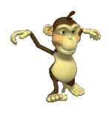
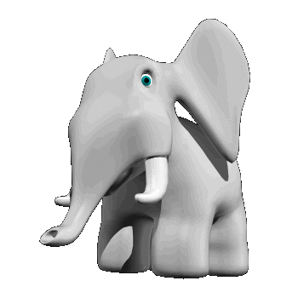
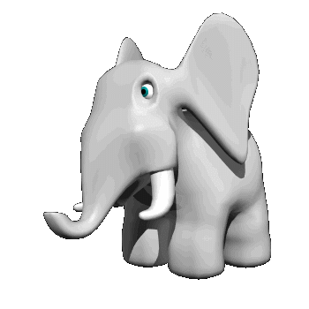
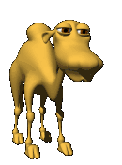
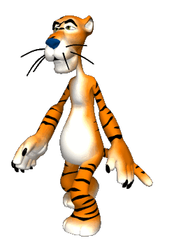
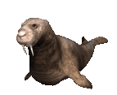
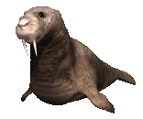
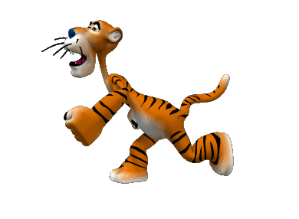
25 ACRES
To get you started here are some examples of what you might do!
Two monkeys
This would have taken care of 7 of the 25 acres. 18 more to go!
Two
Asian
elephants
Two camels
Remember that 2 of each
helps future zoo stock.
Two seals
Two tigers

Slide 6
Questions
1. What economic principle explains why your group didn't put one of every animal in the zoo?
Scarcity. The basic economic problem that arises because people have unlimited wants but resources are limited. Because of scarcity, various economic decisions must be made to allocate resources efficiently.
2. Explain what happens when you chose one animal over another.
If we wanted more of one animal we had to give up more
of another animal. Non-selected animal becomes a Trade-Off. A trade-off involves a sacrifice that must be made because of a decision.
3. Why didn't/did your group put a turkey in your zoo?
Cost Benefits Analysis (turkeys, like cows, are too common) is a systematic approach to estimating the strengths and weaknesses of alternatives
http://yadayadayadaecon.com/clip/7/
4. Why did your group choose an Asian elephant and not an African elephant?
Cost Benefit Analysis (the Asian Elephant takes less land)

Slide 7
Questions [continued]
5. What happens if trade-off animals became hugely popular and your zoo doesn’t have them?
Those non-visiting customers are the “opportunity cost” [“opportunity lost”] The loss of potential gain from other alternatives when one alternative is chosen
6. What animal did everyone in your group agree to include ___?
7. Overall what technique was your group using to build the zoo?
Economic Thinking: Requires a purposeful evaluation of the available opportunities to make the best decision possible

Slide 8
Because of scarcity of time we partake in economic decision making on a daily basis.
What is the trade off of staying in school?
What is the opportunity cost of staying in school?
Why do some students choose to drop out of school?
Why do most students choose to stay in high school and graduate?
What are the future consequences of a decision to drop out of school vs. stay in school?

