Slide 1
Market Structures
One of the most important functions of government is to ensure competition in a free market

Slide 2
Laissez-Faire “allow them to do”
The philosophy that government should not interfere with commerce or trade. Under laissez-faire the role of government is confined to protecting private property, enforcing contracts, settling disputes, and protecting business from increased competition from foreign goods.

Slide 3
Late 1800’s commerce began to change . . .
Due to the changing nature of industry, known as industrialization, competition began to weaken because of acquisitions and mergers. Decreased competition leads to higher prices for consumers and less choice. Therefore, government must play a role.

Slide 4
Determining the competitiveness of Markets
1.How many buyers and suppliers are there? 2.How large are they? 3.Does either have any influence over price? 4.How much competition exist between firms? 5.What kind of product is involved? Are they the same product or just similar? 6.Is it easy or difficult for new firms to enter the market?

Slide 5
Perfect Competition
-Large number of firms -Firms produce identical goods so there is no reason for consumers to express preference or choice. -Freedom of entry and exit into the industry. -Firms are price takers and they have no control over the price of the products. -Each producer supplies a very small quantity of goods into the market. -Both the consumers and producers have a perfect knowledge of the market conditions.
Theoretically ideal situation used to evaluate other markets

Slide 6
Perfect Competition

Slide 7
Monopolistic Competion
-Use advertisements and promotions to make product seem different in order to charge more -A large number of firms exist in the market -They may have some or little control over the price due to product differentiation that exists between them -The products are close but not perfect substitutes. -Entry and exit from the industry Is relatively easy with few barriers to entry and exit.
Has all the conditions of perfect competition except market differentiation which is an attempt to attract more customers.

Slide 8
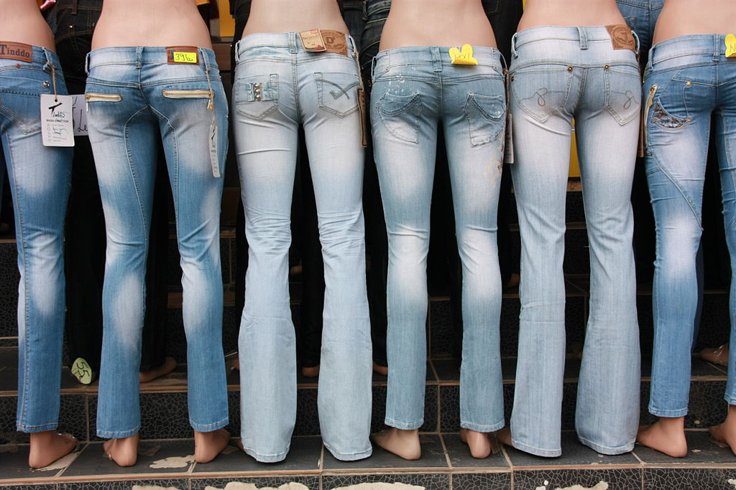
Monopolistic Competition

Slide 9
Oligopoly
-Sellers are price makers and not price takers
-Possibility that the firms may collude and they try to price control the price of the products.
Few very large sellers dominate industry

Slide 10
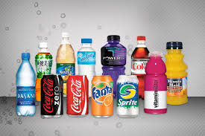
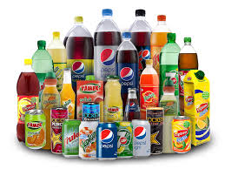
Oligopoly
Coke and Pepsi

Slide 11
Monopoly
-Controls the supply of the product into the market.
-Enjoys full control on the market and factors.
-Difficult entry into market
-Highest degree of imperfection of a market structure.
single seller who is the price-maker and not the price taker

Slide 12
Monopoly

Slide 13
Concerns over the cost of imperfect competition is one reason the government intervenes in the economy.

Slide 14
Historically, the freedom to pursue self interest has led some people to seek economic gain at the expense of others.

Slide 15
Therefore, government must take action to ensure a competitive market

Slide 16
Market Failures and Government Action

Slide 17
Anti-Trust Legislation
-legislation is designed to prevent market failures due to inadequate competition
In the late 1800s US Government passed laws to restrict monopolies and trust

Slide 18
Group Research 1. Sherman Antitrust Act 2. Clayton Antitrust Act 3. Federal Trade Commission
4. Robinson Patman Act

