Slide 1
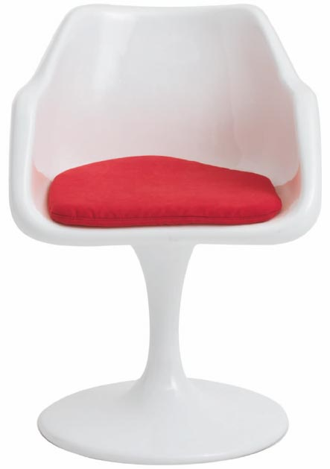
An Introduction to Cap-and-Trade Climate Policy
Using Musical Chairs: An Illustration of Managed Scarcity
Holmes Hummel, PhD
hummelhh@mindspring.com
November 21, 2007
Notes:
1

Slide 2
Climate Economics
Today, consumers (and industries we support) dump an unlimited amount of greenhouse gases into the atmosphere for free.
As a result, fossil fuel prices do not reflect their full cost.
Life on Earth pays the ultimate price: more severe droughts, floods,
fires and storms along with collapsing ecosystems and extinction.
For this reason, some economists have called climate change
“the greatest market failure in history.”
References: IPCC Fourth Assessment Report, Summary for Policy Makers, 2007.
The Economics of Climate Change, Stern Review Report, 2006.

Slide 3
Climate Policy
Policy makers have 2 main options for putting a cost
on greenhouse gas pollution:
(1) a carbon tax or “pollution fee”
(2) creating a market for carbon emissions
In order to stabilize global warming, fossil fuel prices would rise
under either policy.
Americans appear to have little appetite for a carbon tax.
But there is also little understanding of the market-based alternative –
a carbon cap-and-trade program.
How would it work?

Slide 4
Cap-and-Trade Climate Policy
“Cap-and-trade” means a government authority establishes a cap that
limits the total amount of pollution allowed,
and then distributes permits for a “right to pollute” the global atmosphere,
which can be traded as private property.
The amount of greenhouse gas emissions permitted declines each year, creating demand for a new commodity: carbon permits.
When offered enough money (or faced with high enough costs), polluters who own permits (or need permits) will reduce their emissions.
These trades establish a market price for greenhouse gas pollution.
Got it?
A familiar game can help illustrate the concepts…

Slide 5
Musical Chairs: A Helpful Analogy
Each chair represents the “right to pollute”:
one metric ton of carbon dioxide (1 mtCO₂)
or an equivalent amount of any other greenhouse gas
If you have a permit, you can have a chair.
Notes:
5

Slide 6
Musical chairs
2008
At the start of the game, everyone has a seat –
because there are no limits on carbon emissions.
All stick figures by Tormod Lund, GraffleTopia.com
Notes:
6

Slide 7
Musical chairs
2009
After the first year, a cap is imposed by limiting the amount of permits and making players compete for the permits available.
In our analogy, one player doesn’t have a chair…

Slide 8
Would anyone be willing to trade their chair for $30?

Slide 9
Sure! For that price, I can finance an efficiency upgrade, eliminating my need for a pollution permit.
Notes:
9

Slide 10
So, the market price for the “right to pollute” in the first year
is $30 for one ton of carbon dioxide…

Slide 11
Using Market Incentives
2009
At that price, some players may realize it would be more profitable to reduce their emissions and sell their permits.
Profit opportunities are a main driver for innovation and investment in the global economy today, and the climate challenge needs both.

Slide 12
Using Market Incentives
2009
If I could I build wind farms to replace my
coal power plants, then I could sell permits…

Slide 13
Using Market Incentives
2010
Hey, I made a profit by reducing my fossil fuel use and avoiding carbon emission costs!
Notes:
13

Slide 14
Achieving Reduction Targets
2010
The purpose of the game is to reduce greenhouse gas emissions.
The game authority reduces the number of permits available
each year until the ultimate target has been achieved.

Slide 15
Achieving Reduction Targets
2050
2040
2030
2020
2010
In a market, players leave when they find better options as costs rise.
Cap-and-trade lets players choose at what price they leave the game
– and how they want to make that change.
Rail Transport
Hybrid vehicle
Nuclear power
Solar power
Wind power
Green buildings
$100
$50
$200
$20
$150
$30
Notes:
15

Slide 16
Achieving Reduction Targets
2050
Who will be the last greenhouse gas polluters left in the game?

Slide 17
Achieving Reduction Targets
2050
The last ones remaining in the game are those who:
can afford to pay the most, or
have the least flexibility to change games.
The underlying assumption is that uses of fossil fuels for which people are willing to pay the most must be the most valuable.
To stabilize global warming, most uses of coal, oil, and gas will have to move to a different game: the clean energy economy.

Slide 18
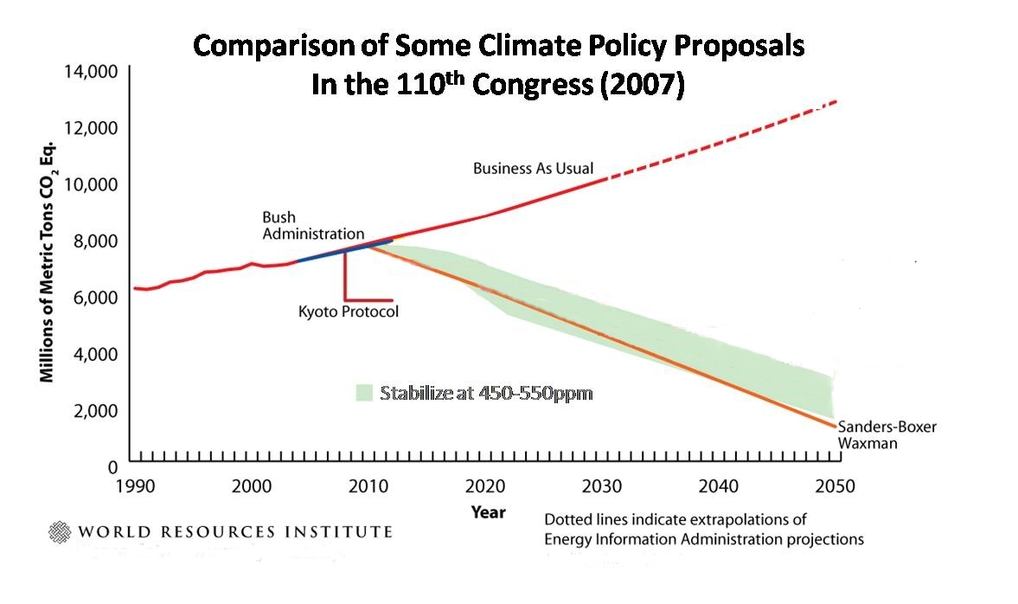
Achieving Reduction Targets
2050
To avoid the worst climate impacts, the U.S. must eliminate at least 80% of its emissions by 2050.
Comparison of Two Leading Climate Policy
Proposals in the 110th Congress (2007)
Warner-Lieberman
Stabilize at 450-550ppm
Chart modified for clarity

Slide 19
Achieving Reduction Targets
2020
There are no “time out” options between rounds.
As the cap tightens in each new round, fewer permits are available.
So, players with permits charge the buyers higher prices.
SELL
PRICE:
$90
$90
$90
Notes:
19

Slide 20
Achieving Reduction Targets
2020
As high as it takes to motivate one of us to stand up.
How high can
the price go?
SELL
PRICE:
$90
$90
$90

Slide 21
The Carbon Market at Work
So, is it cheaper for me to:
buy a permit from another player, OR
reduce my own emissions?
SELL
PRICE:
$90
$90
$90
Notes:
21

Slide 22
Coverage and Distribution
Two critical aspects of cap-and-trade are determined by how each round begins:
1. Which polluters should be required to play?
2. Should polluters have to buy permits in an auction –
or should they receive a free allocation of permits?

Slide 23
Coverage
For practical reasons, most proposals only require fossil fuel suppliers and large polluters to play directly.
As they pass on their costs, the rest of the economy is affected.
Examples of “covered” pollution sources:
Oil
Refineries
Power
Plants
Mining
plants
Aluminum
smelters
Coal
companies
Natural Gas
companies
Chemical
companies
Notes:
23

Slide 24
Auctioning Permits vs Allocating for Free
Though sales of coal, oil, and gas should decline as carbon prices rise,
economists say less than 20% of the permits should be given for free to compensate those firms for additional profits they might have had otherwise.
Free permits
allocated to fossil fuel
companies
Permits auctioned
to “covered” companies
BUY:
$0
$20
$20
$20
$20
$20
$20
Reference: Lawrence Goulder, Congressional Budget Office Conference on Climate Change, 2007.

Slide 25
Auctioning Permits vs Allocating for Free
By contrast, the Lieberman-Warner bill for U.S. climate policy proposes giving away more than half the permits.*
Those companies start out each round “sitting down” at no cost.
2012
Free permits
allocated to corporations
Auctioned permits
bought by corporations
BUY:
$0
$0
$0
$0
$0
$20
$20
* Though portion would change over time, 1/4 are still free in 2050.

Slide 26
Auctioning Permits vs Allocating for Free
Why is this a cause for concern?
1. Unfair competition: New players entering the market with innovative ideas have difficulty competing against pre-existing polluters who get free permits as a subsidy to diminish their political opposition.
Free permits
Auctioned permits
BUY:
$0
$0
$0
$0
$0
$20
$20
Notes:
26

Slide 27
Auctioning Permits vs Allocating for Free
Why is this a cause for concern?
2. Unearned windfall profits: In a carbon market, firms that buy permits in an auction will try to pass costs to customers, and others receiving a permit for free can sell their permits at that same price.
Free permits
Auctioned permits
BUY:
$0
$0
$0
$0
$0
$20
$20

Slide 28
Auctioning Permits vs Allocating for Free
Why is this a cause for concern?
2. Unearned windfall profits: In a carbon market, firms that buy permits in an auction will try to pass costs to customers, and others receiving a permit for free can sell their permits at that same price.
BUY:
$0
$0
$0
$0
$0
$20
$20
SELL:
$20
$20
$20
$20
$20
$20
$20
Unearned windfall profits
Cost passed to consumers
Notes:
28

Slide 29
Spending
With hundreds of billions of dollars being raised, expectations are high about who could benefit from climate policy – and how:
Tax credits and Incentives – support for efficiency and zero carbon energy sources
Research & Development – on the scale of a New Apollo Project or a Manhattan Project for zero carbon energy sources
Low-income Households – committing at least 15% of all revenues to neutralizing impact of higher prices on fossil fuels and other goods
Adaptation – helping vulnerable communities (1) avoid harm from climate change, and (2) recover from climate damages
Green Collar Jobs – encouraging job development in the clean energy industry
x

Slide 30
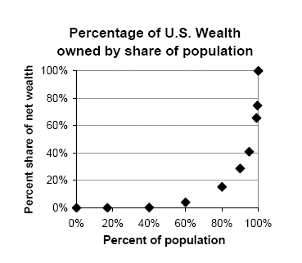
Concerns about Equity
Most unearned windfall profits would go to shareholders who are members of the top 10% most wealthy households in the U.S.
The top 10% of U.S. households already own 2/3 of the wealth,
and the top 1% own half of that!
References: State of Working America, 2006; data from U.S. government agencies (Census, IRS, BLS)
Notes:
30

Slide 31
Concerns about Equity
A carbon tax and a cap-and-trade policy
both would raise fossil fuel prices.
Prices of products and services that use fossil fuels would also rise.
This would impose hardship on low-income households unless the climate policy specifically includes “carbon cost rebate” measures funded with revenues raised from either a tax or a permit auction.

Slide 32
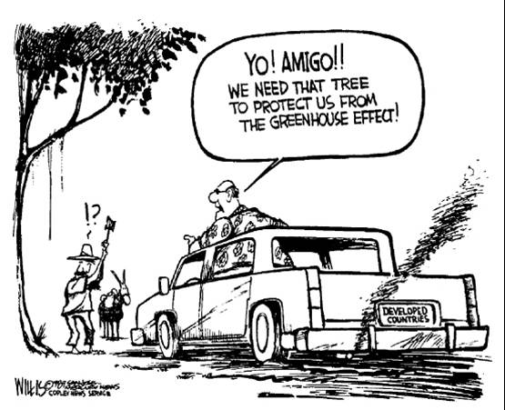
Concerns about Equity
Under either a carbon tax or a carbon cap-and-trade policy,
wealthy people would be able to take advantage of their class
privilege to use more fossil fuels – both nationally and globally.
In order to withstand popular opposition to higher fossil fuel prices,
any climate policy must be widely regarded as fair by a broad base
of beneficiaries.
Notes:
32

Slide 33
Additional Questions to Consider
Is it ethical to privatize the sky and treat pollution as a commodity traded like private property?
Is it ethical to make a profit from carbon trading?
Will the complexity of a cap-and-trade system rival our tax system, opening similar opportunities for loopholes and favored treatment?
Would our political institutions be reliable to manage this massive new market over decades under tremendous pressure?
And if federal climate policy is not forthcoming from Congress fast enough…
What local, state, corporate, and regional policies for energy, agriculture, science, taxes, and trade could be pursued to meet the challenge?
Notes:
33

Slide 34
For Further Reference
The following public interest organizations have a strong focus on climate policy design and development in the U.S.:
World Resources Institute www.wri.org
Pew Center on Global Climate Change www.pewclimate.org
Resources For the Future www.rff.org
Union of Concerned Scientists www.ucsusa.org
Feedback on this illustrated introduction to cap-and-trade concepts is most welcome: hummelhh@mindspring.com.
x

