Slide 1
Essential Question:
What impact did immigration and urbanization have on American life during the Gilded Age (1870-1900)?
CPUSH Agenda for Unit 7.4:
Clicker Questions
“Immigration and Urbanization” notes
Today’s HW: 14.2
Unit 7 Test: Friday, November 16
Performance Final: Tuesday, November 27

Slide 2
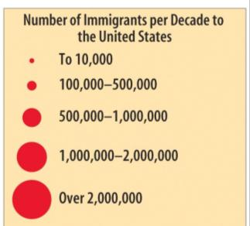
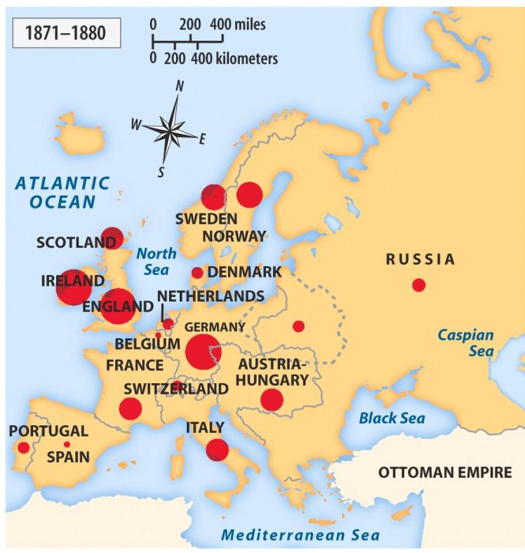
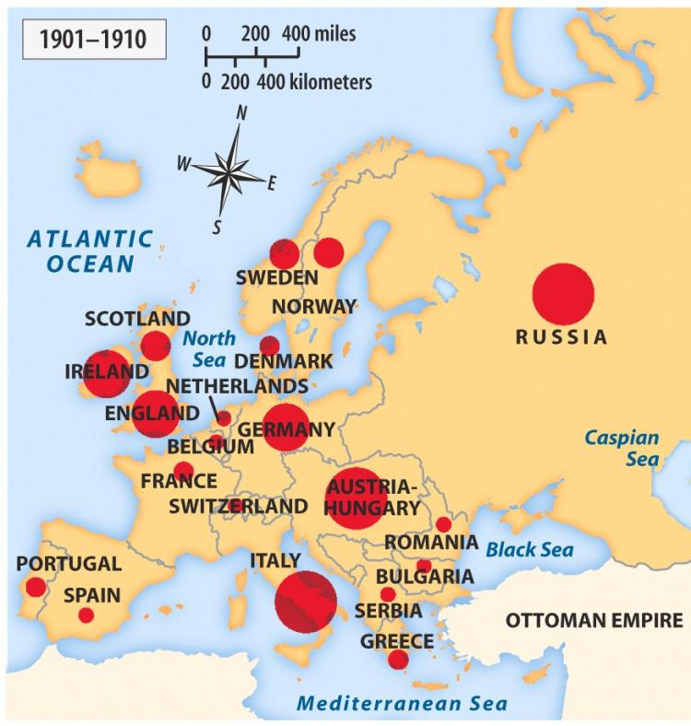
What was immigration like during the Gilded Age?

Slide 3
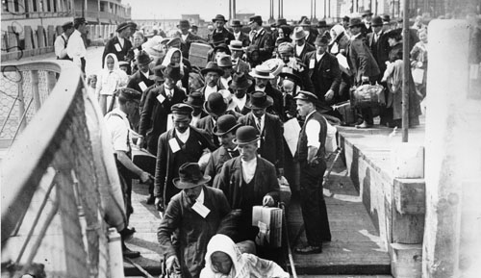
From 1880 to 1921, a record 23 million immigrants arrived in the U.S. looking for jobs and opportunities
The USA did not have quotas (limits) on how many immigrants from a particular country could enter the country
Notes:
From 1880 to 1921, a record setting 23 million immigrants arrived in the USA. At the time,.
From the colonial era to 1880, most immigrants to America came from England, Ireland, or Germany in Northern Europe. Between 1880 and 1921, approximately 70% of all immigrants entering the USA came from southern and eastern Europe (Italy, Austria-Hungary, Russia, Poland).
These “new immigrants” were typically young, male, and either Catholic or Jewish. Most spoke little or no English. The majority were unskilled agricultural laborers with little money or education.

Slide 4
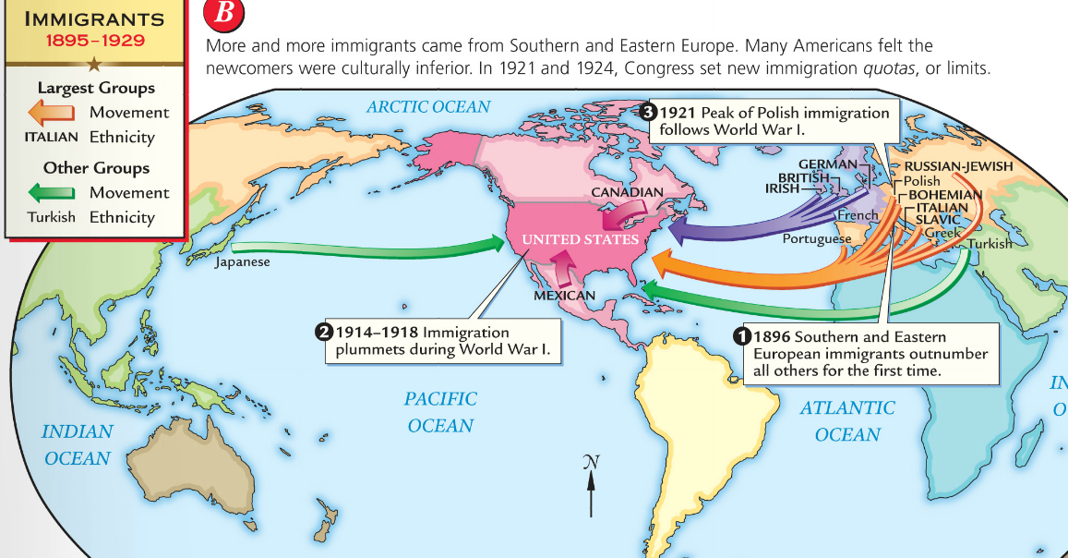
From the colonial era to 1880, most immigrants came from England, Ireland, or Germany in Northern Europe
Between 1880 and 1921, 70% of all immigrants to the USA came from southern and eastern Europe (Italy, Poland, Austria-Hungary, Russia)
The “new immigrants” were typically young, male, either Catholic or Jewish, and spoke little or no English
The majority were unskilled agricultural laborers with little money or education

Slide 5
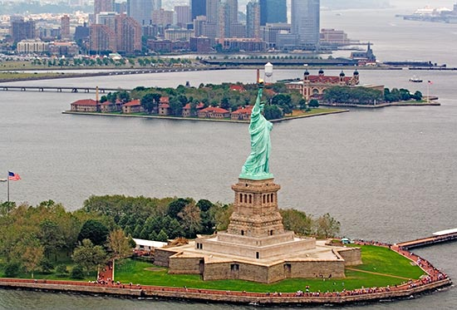
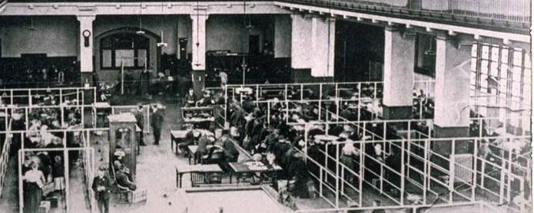
75% of all immigrants entered the USA through the immigration center at Ellis Island, in New York
Immigrants had to pass a health examination and anyone with a serious health problem or disease was not let in
Inspectors questioned immigrants to made sure that they were not criminals, could work, and had some money ($25)
Notes:
The processing of immigrants on Ellis Island was an ordeal that might take five hours or more. First, they.
Those who passed the medical exam then reported to a government inspector. The

Slide 6
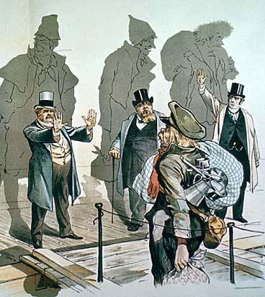
Many Americans expressed nativism and viewed immigrants with a sense of fear, suspicion, and hostility
Nativists had deep-seated prejudices about immigrants based on ethnicity, religion, political and social beliefs
Many Americans accused immigrants of taking jobs away from “real” Americans and called for quotas that would limit the number of immigrants

Slide 7
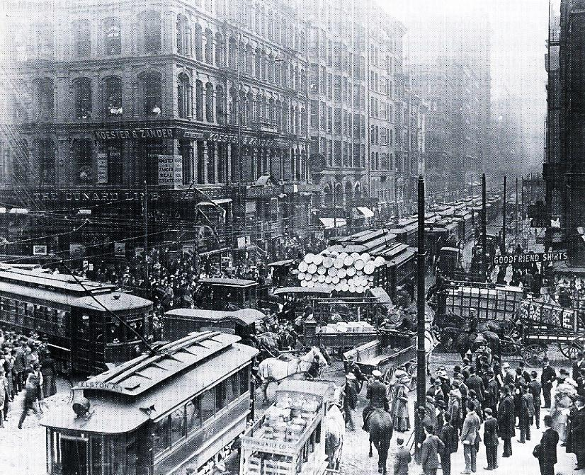
What were cities like in the Gilded Age?

Slide 8
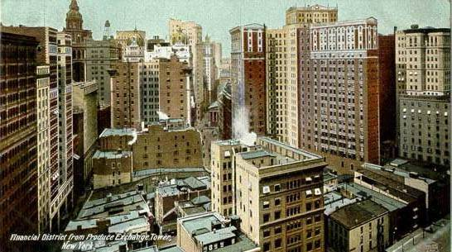
The Gilded Age experienced massive urbanization
In 1850, only 15% of Americans lived in cities…
City growth was due to rural Americans moving to cities and immigrants entering the USA
…By 1900, 40% of Americans lived in cities

Slide 9
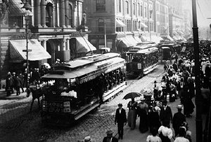
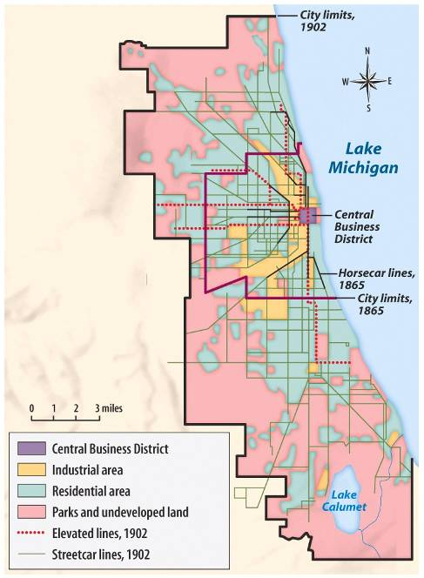
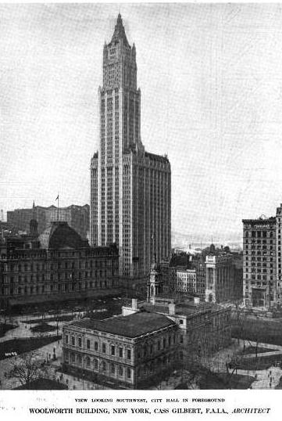
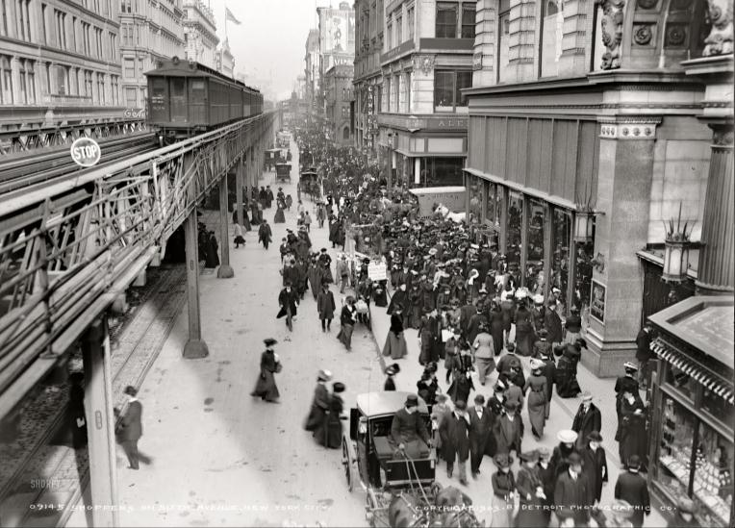
Engineering innovations, such as expansive bridges and skyscrapers, led to modern American cities
Cities expanded outward from industrial centers in the central business districts to a ring of outer suburbs
As cities grew larger and beyond walking distance, trolley lines, elevated rail lines, and subways were created

Slide 10
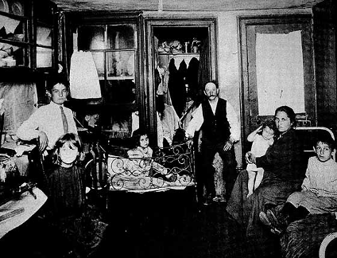
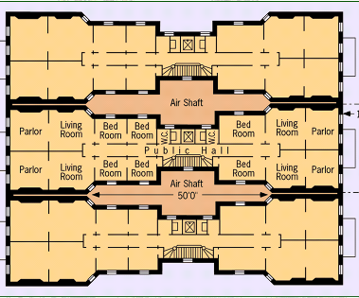
Most American cities were not prepared for such rapid population growth
Many urban poor developed lung disease or tuberculosis; About 60% of immigrant babies died before their first birthday
Most urban immigrants lived in tenements: low rent apartments built the poorest parts of town called slums
Notes:
Half of Manhattan’s fires were in tenement buildings.

Slide 11
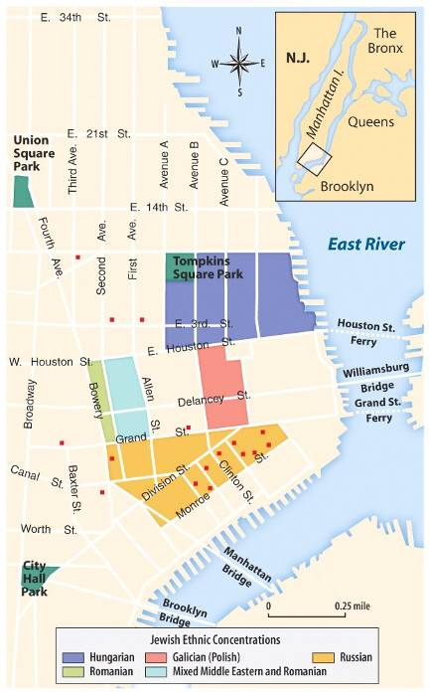
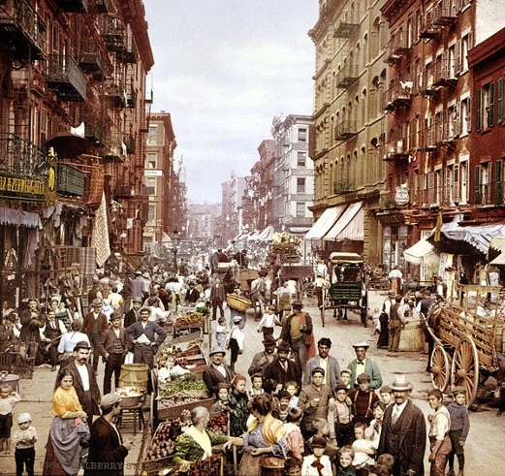
About 2/3 of immigrants settled in cities, such as New York, Chicago, Boston, or Philadelphia and lived in ethnic neighborhoods called enclaves
Enclaves provided new immigrants with a sense of community and security, as the immigrants were surrounded by the familiar customs, food and language of their homeland

Slide 12
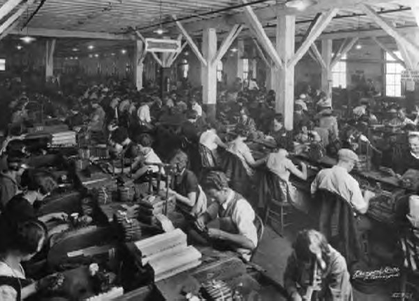
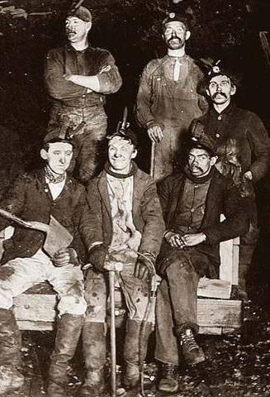
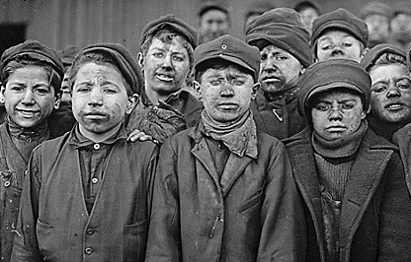
What were working conditions like in the Gilded Age?

Slide 13
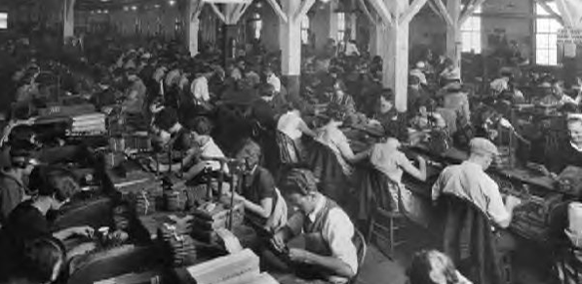
The majority of immigrants worked in industrial jobs
Industries were rapidly growing and in need of cheap workers
Most immigrants were unskilled and were willing to accept almost any kind of job, no matter how un-attractive or low paying

Slide 14
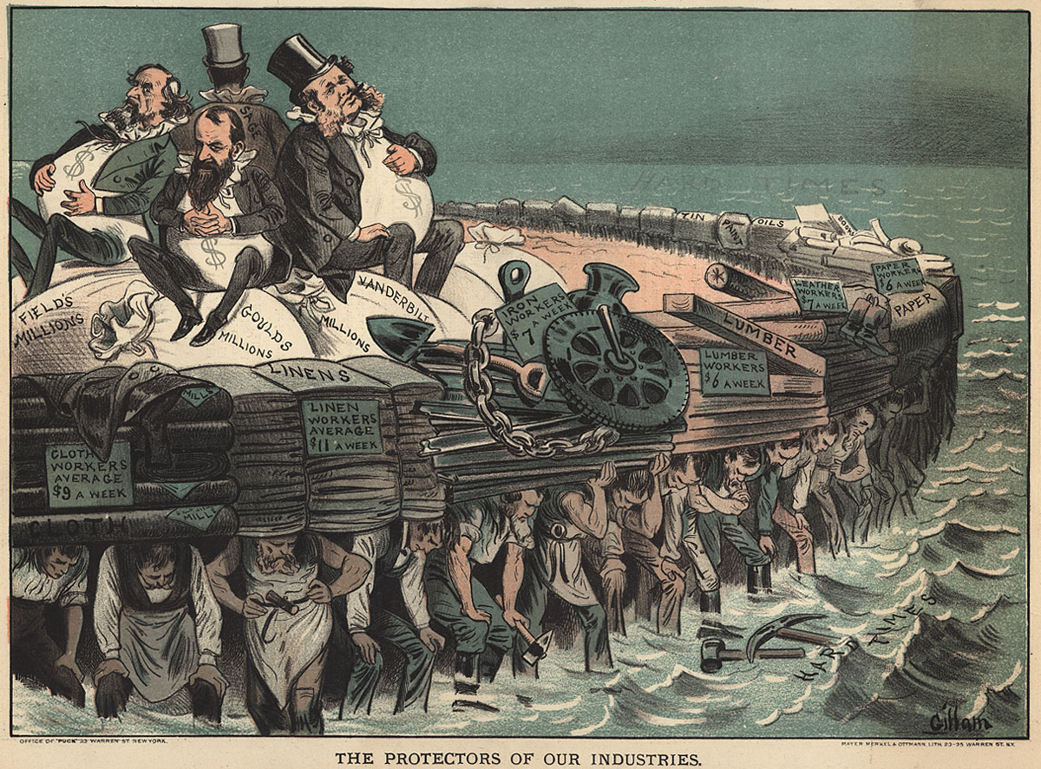
What problems did workers face in the Gilded Age?
3 images

Slide 15
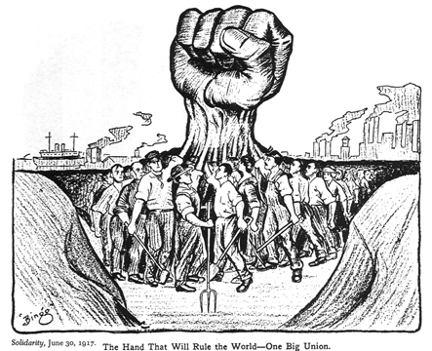
In response to the low wages, long hours, and dangerous working conditions, many workers joined labor unions to collectively bargain for improvements

Slide 16
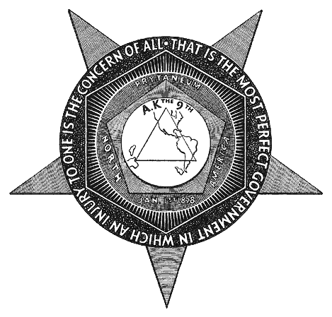
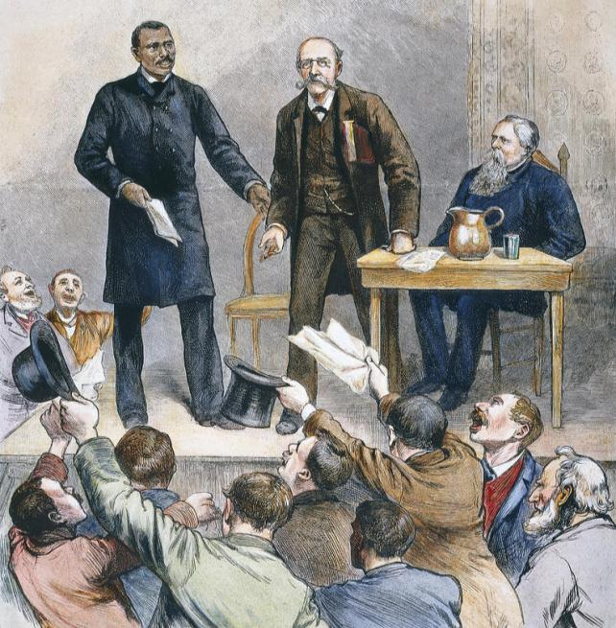
Among the first labor unions in America was the Knights of Labor
The Knights of Labor was open to all workers regardless of race, gender, or skill

Slide 17
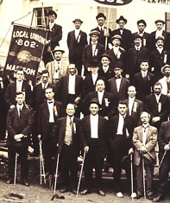
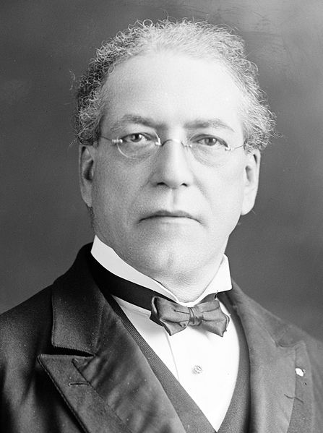
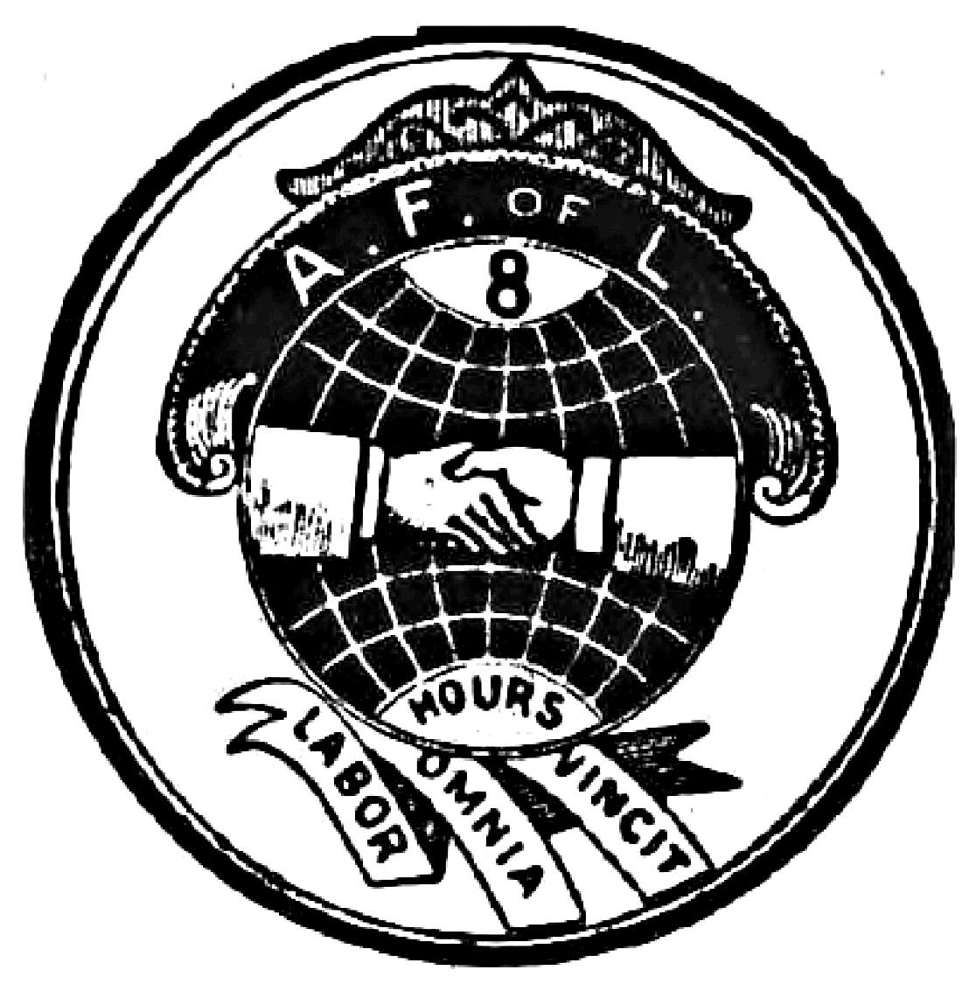
The most successful union was the American Federation of Labor (AFL) led by Samuel Gompers
The AFL only included skilled workers, but it used collective bargaining to gain better pay, shorter hours, and better working conditions for its union members
Most workers were unskilled and ineligible to join the AFL

Slide 18
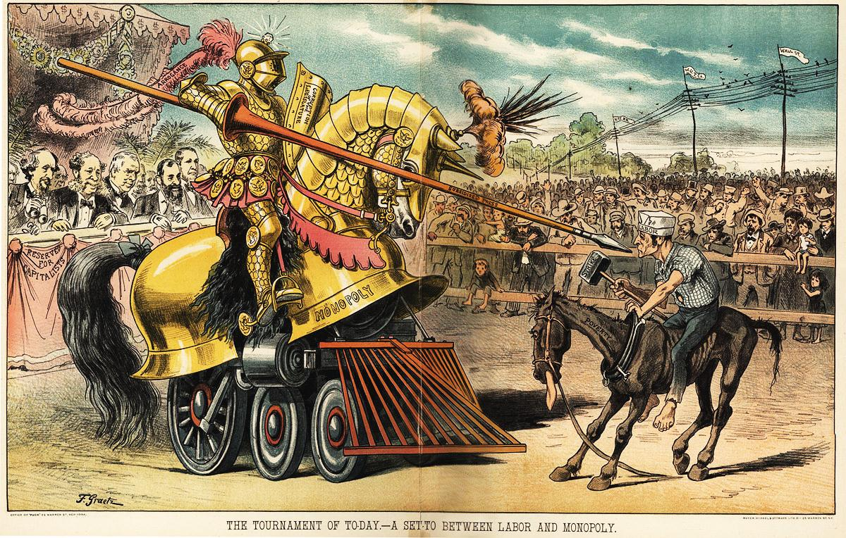
By the end of the Gilded Age, only 4% of all American workers were unionized

Slide 19
One of the tactics used by unions was to strike: Strikes were designed to stop production in order to force management to accept union demands
Business leaders resisted strikes by hiring replacement workers or private police to break up strikes
During some strikes, violence broke out

Slide 20
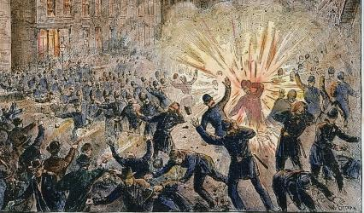
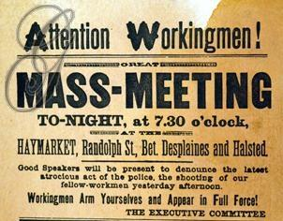
During the Chicago Haymarket Strike (1886), unionists demanded an 8-hr day; When violence broke out, public opinion turned against unions, viewing them as violent and “un-American”

Slide 21
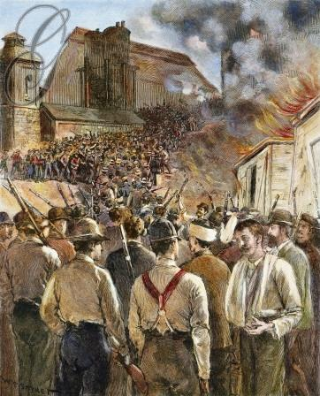
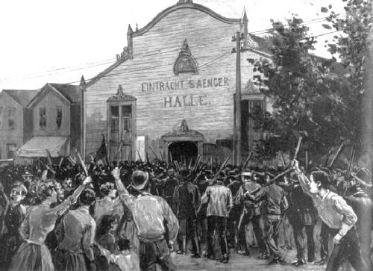
Violence erupted in the Homestead Strike (1892) at Carnegie’s steel plant; Federal troops were called to re-open the factory with replacement workers

Slide 22
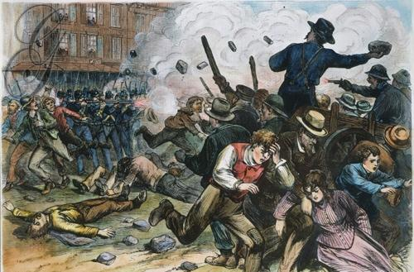
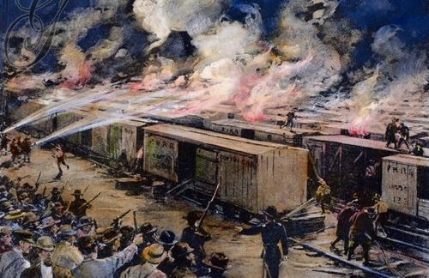
Railroad workers led a national strike when the Pullman Palace Company cut wages by 50%...
…President Cleveland sent the army to end the strike; Strikers in 27 states resisted & dozens died

Slide 23
Essential Question:
What impact did immigration and urbanization have on American life during the Gilded Age (1870-1900)?
CPUSH Agenda for Unit 7.5:
Clicker Questions
“Immigration and Urbanization” notes
Today’s HW: 14.3
Unit 7 Test: Friday, November 16
Performance Final: Tuesday, November 27

Slide 24
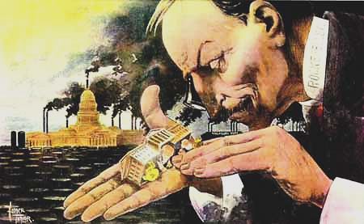
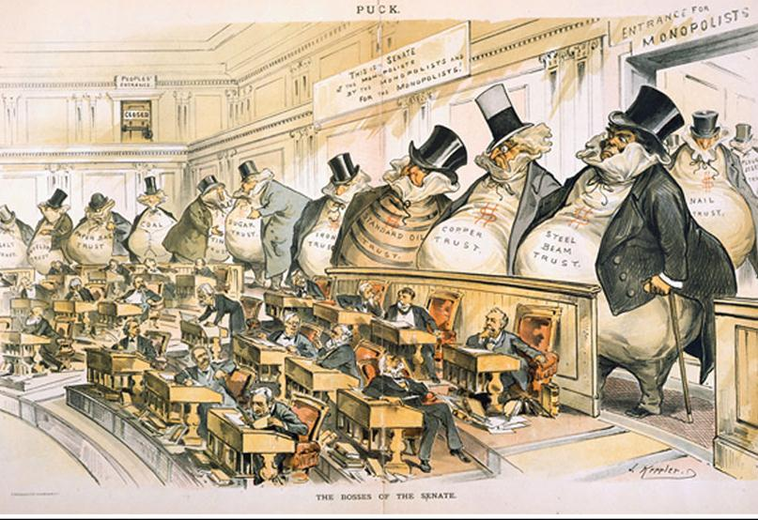
What problems did government face in the Gilded Age?

Slide 25
The Gilded Age was an era of political corruption in national, state, and urban governments

Slide 26
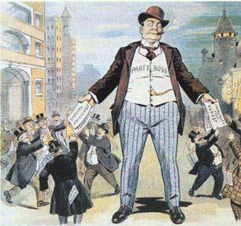
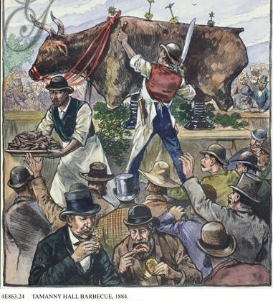
Many city governments were run by political machines
Political machines were parties led by a powerful boss who controlled a network of politicians
Machines politicians rallied citizens, especially immigrants, to vote for them by offering services

Slide 27
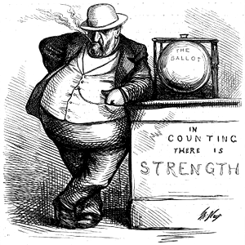
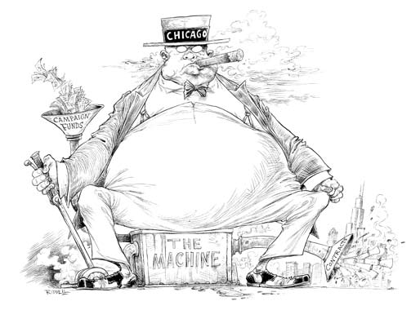
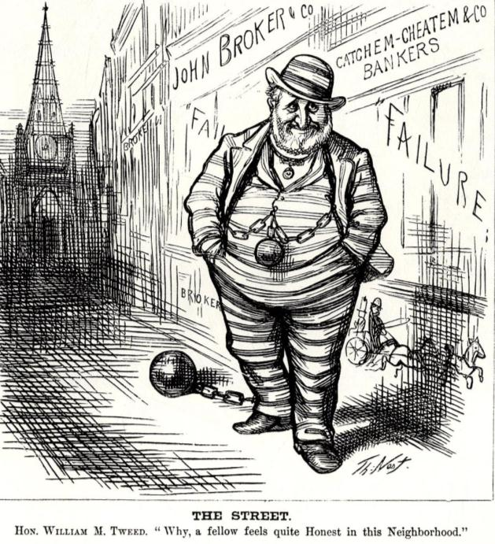
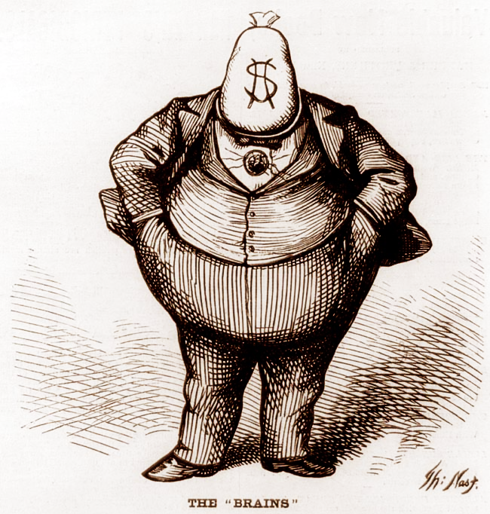
Many city governments were run by political machines
Because machine politicians controlled access to city jobs, business licenses, and building projects, they tended to be corrupt
Many politicians used fraud to win elections, used their influence for personal gain (graft), or took bribes
The most notorious urban politician was Boss Tweed of New York’s Tammany Hall political machine
The “Tweed Ring” defrauded New York City of millions of dollars until it was exposed by reporter Thomas Nast
Notes:
“Tweed Courthouse”—NY County Courthouse was supposed to cost $250,000 but cost $13 million

Slide 28
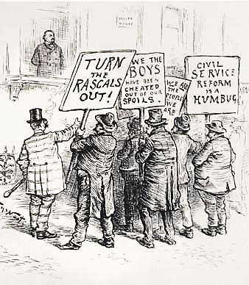
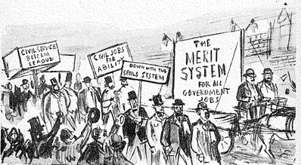
Many government positions,such as tax collectors or post office officials, were appointed as rewards for loyalty to a political party (called patronage)
Congress passed the Pendleton Act in 1883 that created merit-based exams for most civil service jobs in the federal government

Slide 29
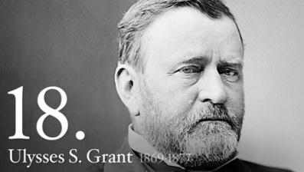
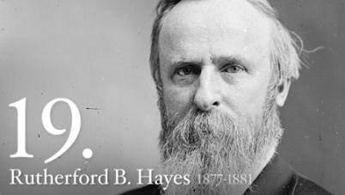
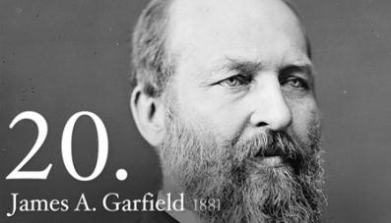
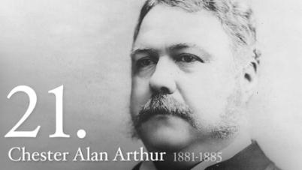
In the Gilded Age, presidents were seen as less powerful than monopolists like Carnegie, JP Morgan, and Rockefeller

Slide 30
Grant was the most important president of the era, but his administration was plagued by scandals
The worst scandal was Crédit Mobilier which involved bribes by railroad companies to gain lands grants
Whiskey Ring involved companies bribing government officials to avoid paying taxes

Slide 31
What was leisure time in the Gilded Age?

Slide 32
While working and living conditions were difficult for poor immigrants, middle-class Americans actually saw their work time decrease
Many middle-class Americans fought off city congestion and their jobs by enjoying amusement parks, bicycling, vaudeville theater (variety shows), and sports such as baseball and boxing

Slide 33
Conclusions: During the Gilded Age, the United States was a land of opportunity
Millions of “new immigrants” swarmed to the U.S. from Eastern and Southern Europe, swelling American cities
The industrial revolution created jobs in Eastern factories
Urbanization stimulated industry and modernized cities, but led to terrible conditions for poor workers and immigrants

Slide 34
Identify the top 5 changes of the Gilded Age Rank order and be ready to explain your list

