Slide 1
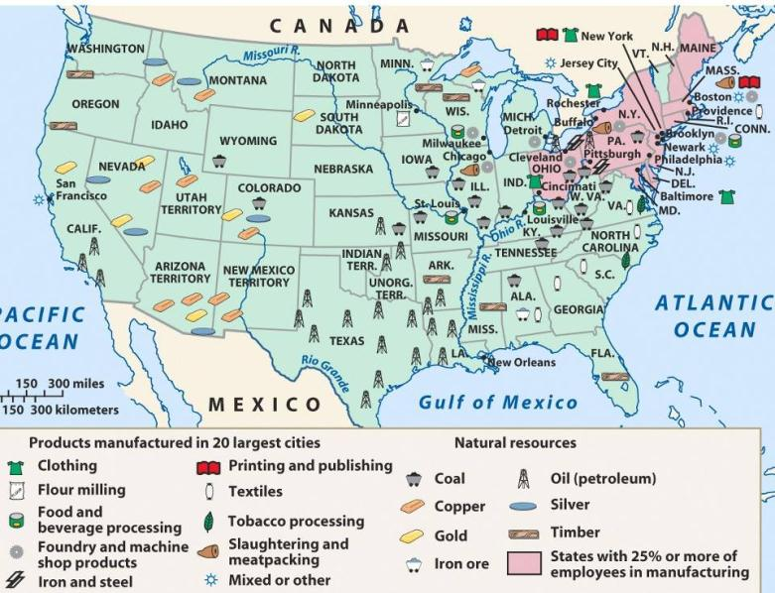
During the Gilded Age, the United States experienced an industrial revolution

Slide 2
America’s industrial revolution was fueled by 4 major industries (R.O.S.E.) Railroads, Oil, Steel, Electricity

Slide 3
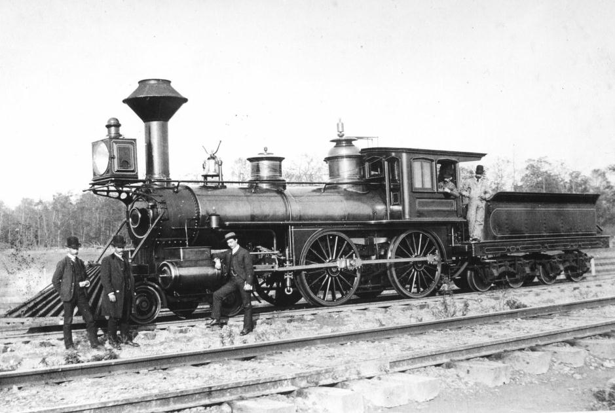
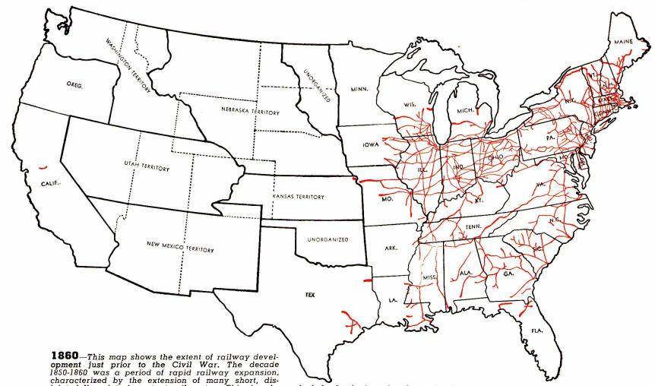
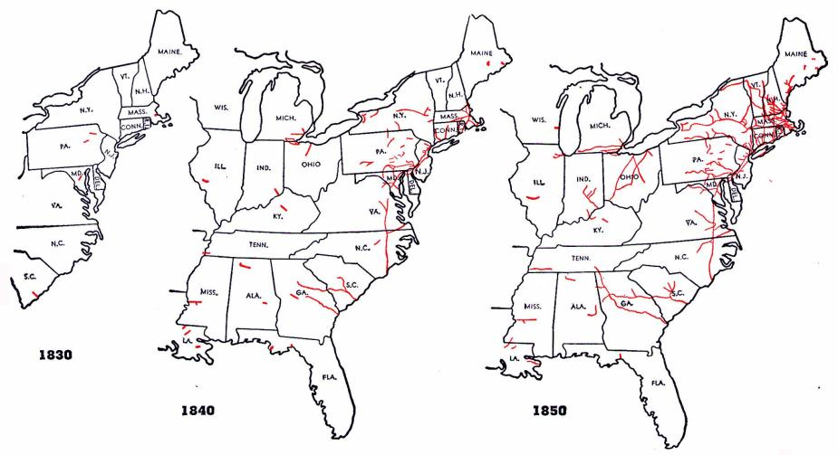
The railroad was America’s first “big business”
Railroad construction grew in the years before the Civil War…
…But, tracks were owned by different companies and were not standardized

Slide 4
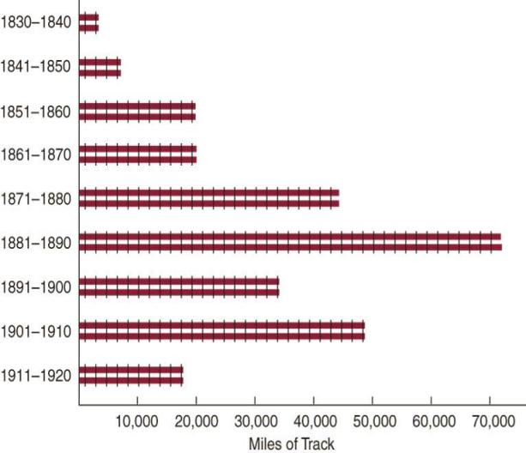
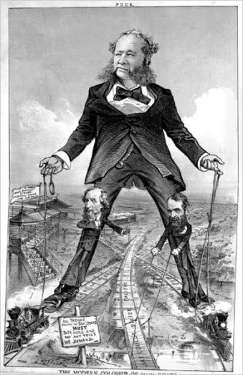
During the Gilded Age, railroad construction boomed, led by tycoons like Cornelius Vanderbilt
Large companies bought small railroads, standardized gauges and schedules, and pooled cars
Cornelius Vanderbilt (3.47)

Slide 5
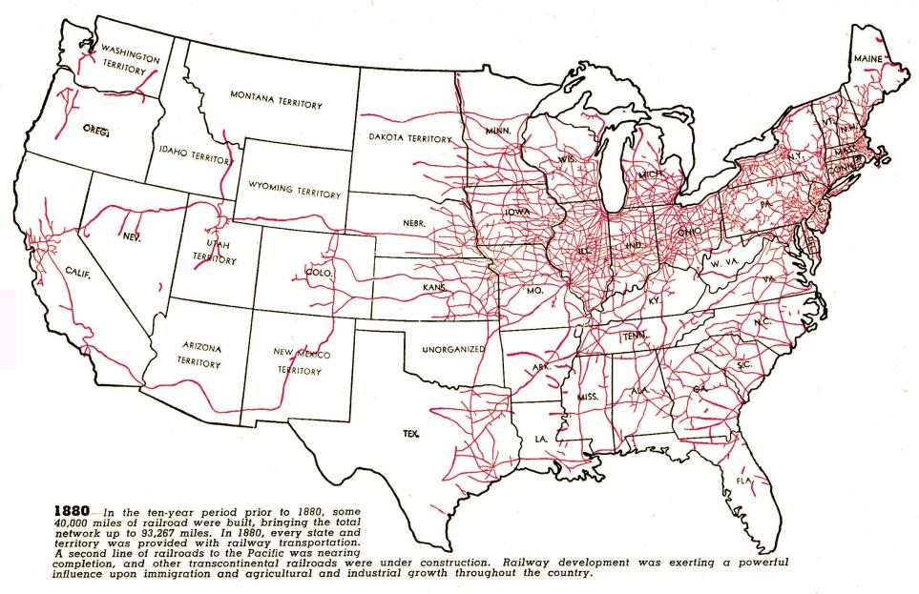
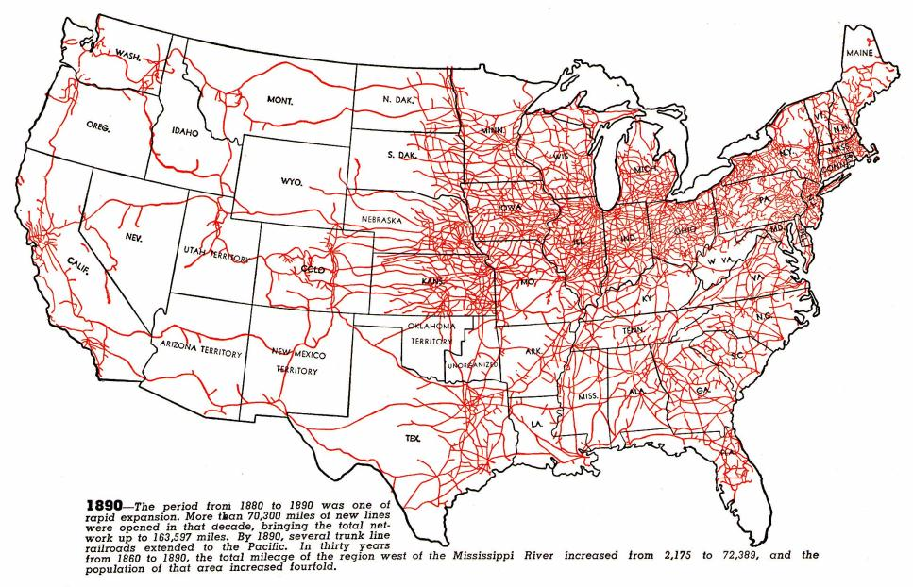
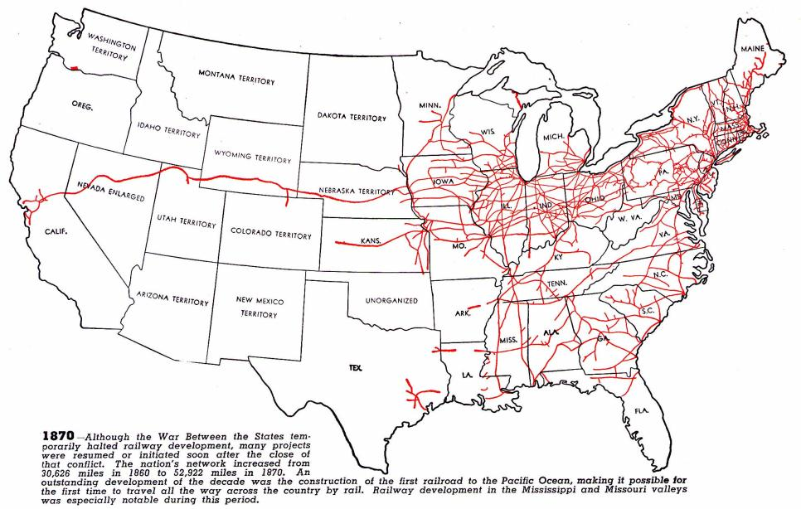
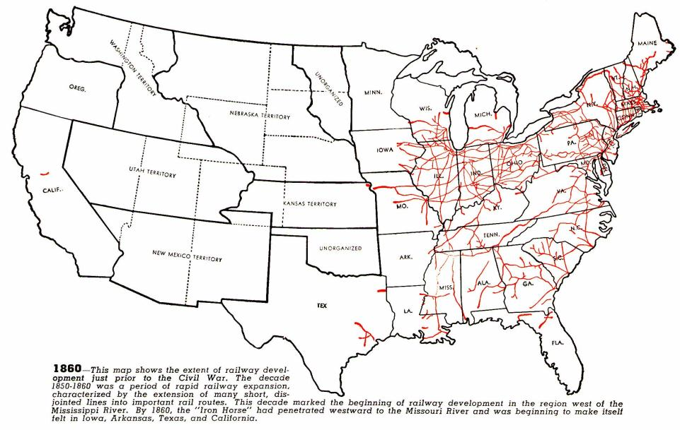
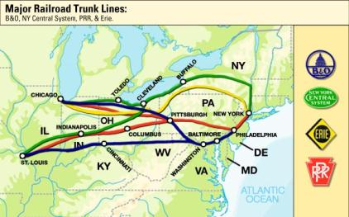
Railroad expansion led to a boom in the economy
Railroads connected the East, South, and West and allowed for national trade and regional specialization
The 1st transcontinental railroad was finished in 1869
Eastern railroads were connected to the West by 4 great trunk lines
Railroads stimulated demand for coal, oil, iron, and steel

Slide 6
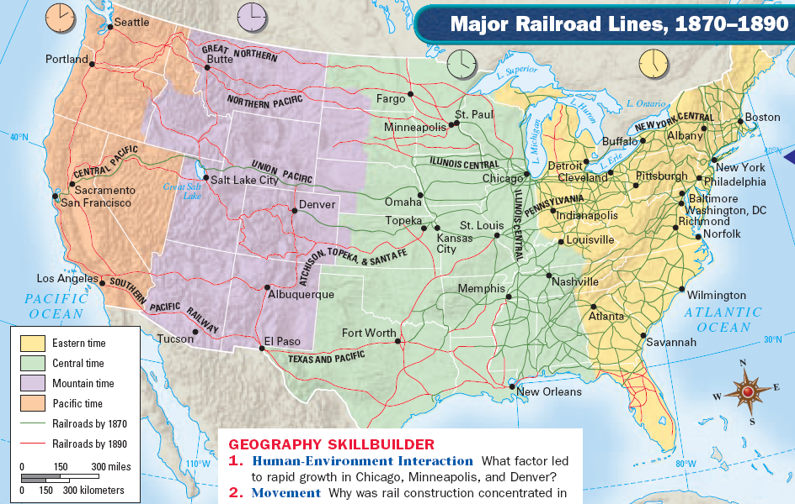

Slide 7
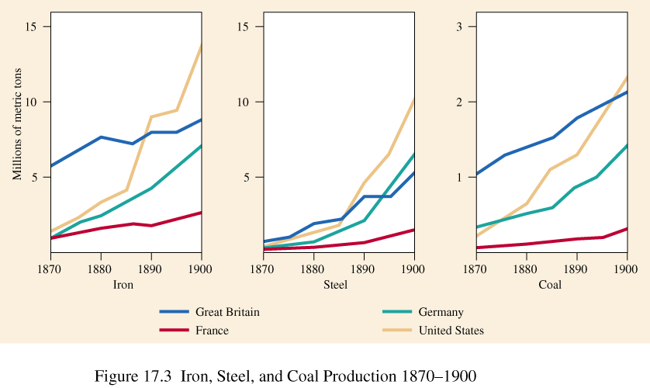
Industrialization led to a demand for iron and steel

Slide 8
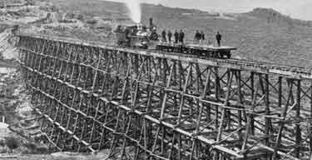
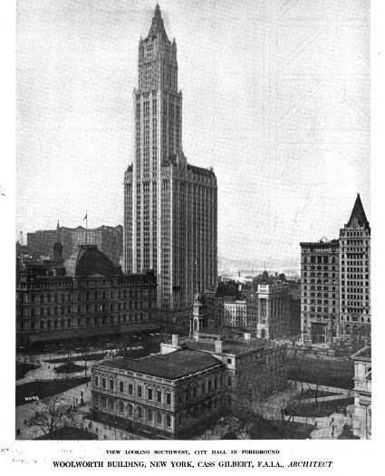
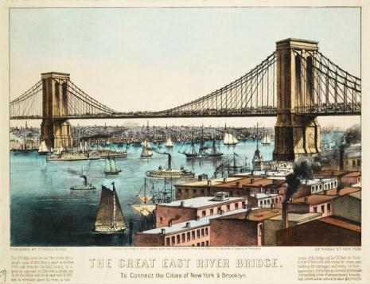
Steel led to skyscrapers, longer bridges, stronger railroads, and heavier machinery

Slide 9
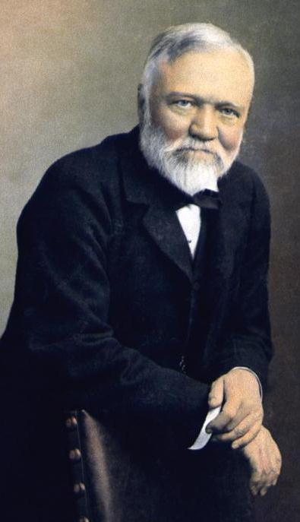
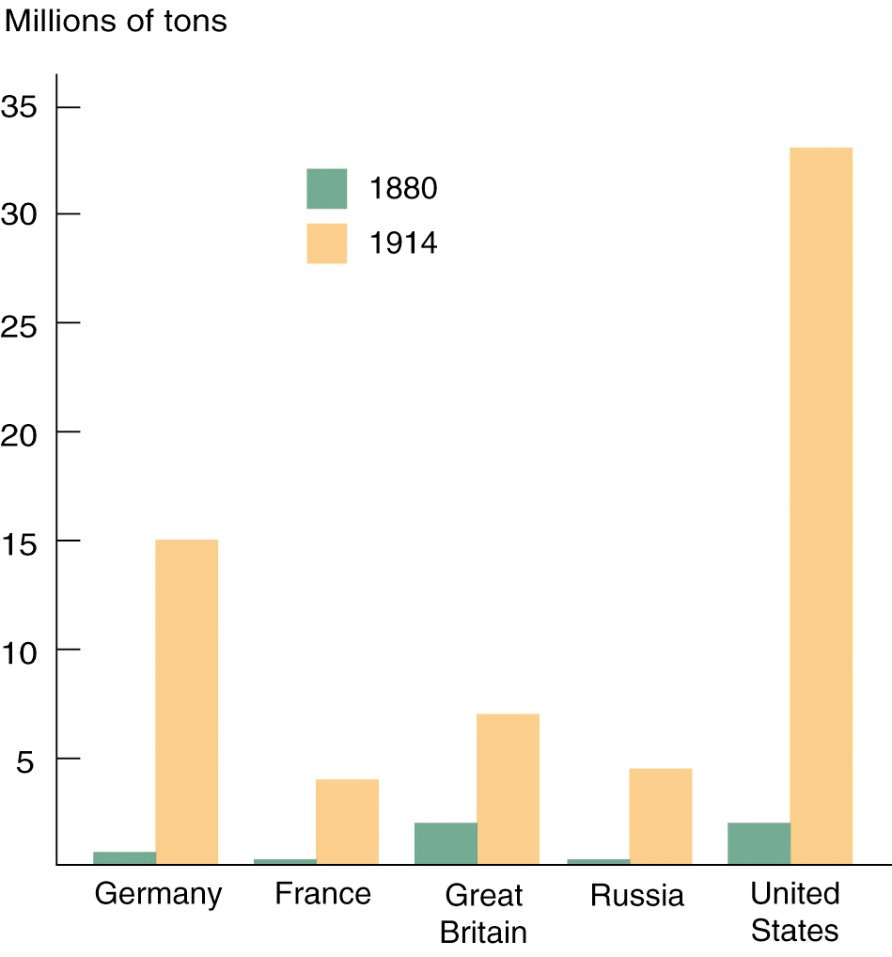
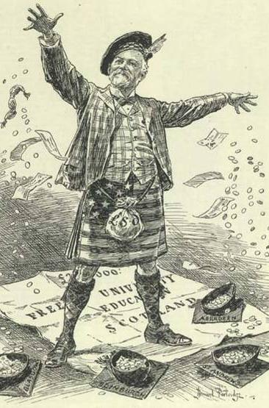
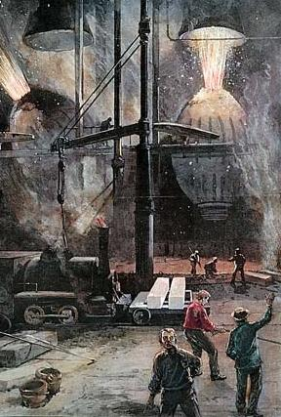
The iron and steel industries were dominated by Andrew Carnegie
Carnegie converted his mills to the Bessemer process and made the highest quality steel at the lowest price
Carnegie Steel Company produced more steel than all the steel factories in Great Britain combined
Carnegie best represented the American dream by rising from poor a immigrant to richest man in the world

Slide 10
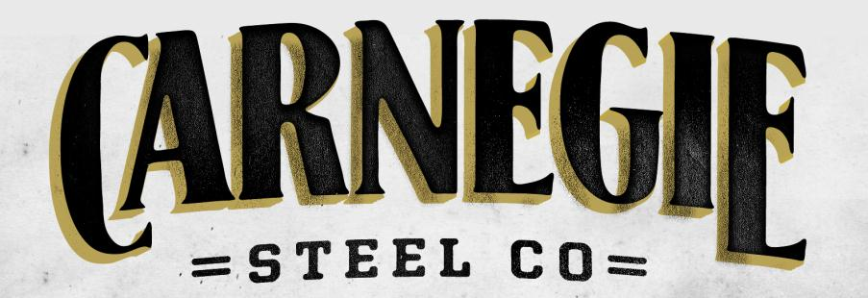
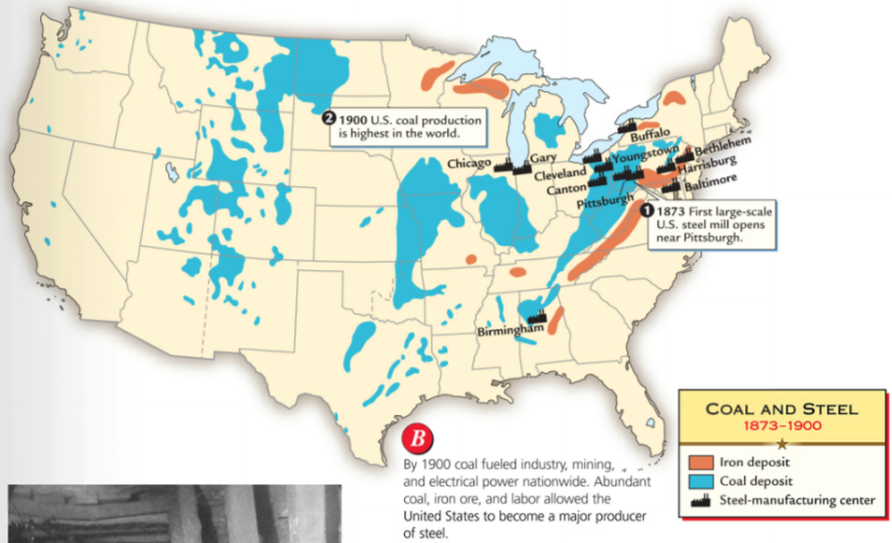
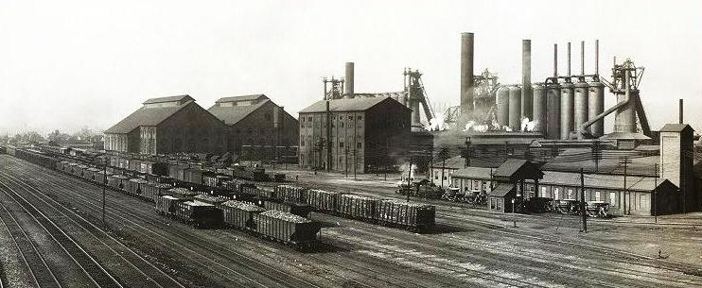

Slide 11
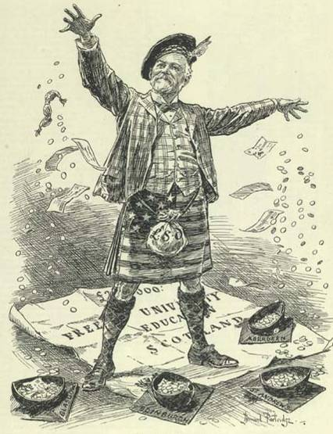
Carnegie did not pay his employees very much and did not allow unions in his factories…
…but he was a philanthropist who gave money to New York City libraries, colleges, and performing arts institutions
Andrew Andrew Carnegie Andrew Carnegie (2.11)

Slide 12
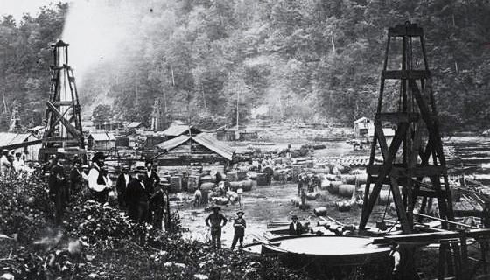
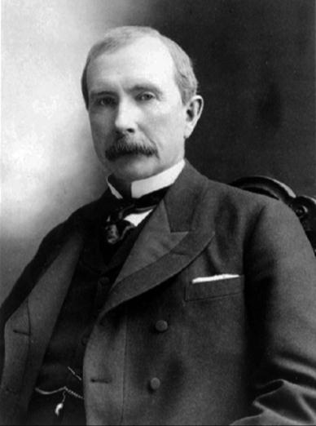
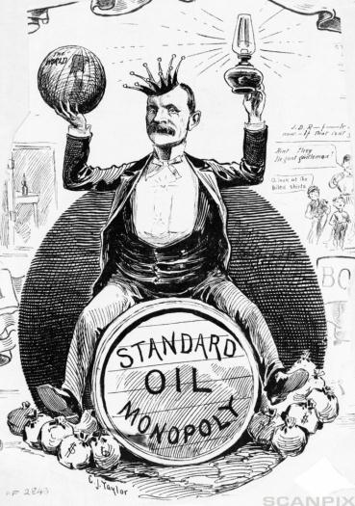
Industrialization led to a demand for oil for lubrication and kerosene lighting
The oil industry during the Gilded Age was dominated John D. Rockefeller’s Standard Oil Company
Rockefeller used ruthless tactics to buy out competing companies
Standard Oil lowered costs and improved the quality of its oil products
By 1879, Standard Oil sold 90% of the oil in America
John D. Rockefeller (2.51)

Slide 13
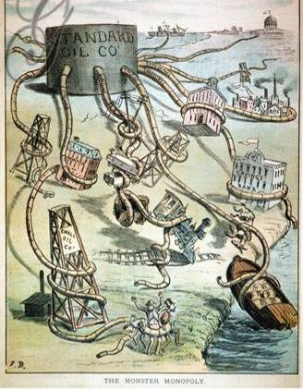
Rockefeller took advantage of his workers and used his fortune to influence the national gov’t…
…but Rockefeller gave away $500 million to charities, created the Rockefeller Foundation, and founded the University of Chicago

Slide 14
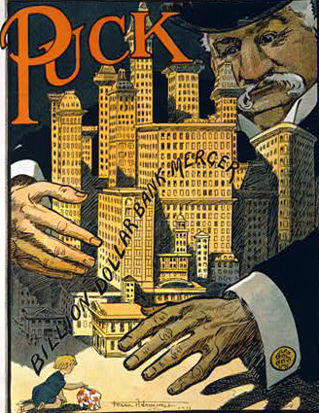
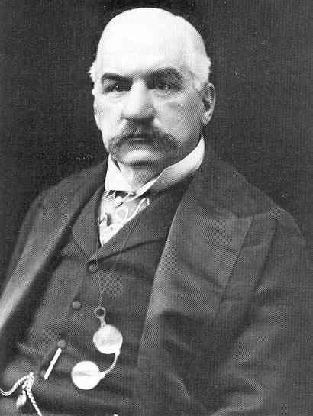
Industrialization led to a demand for financing so banking became a significant part of the Gilded Age
American finance was dominated by JP Morgan
He was so influential that he bailed out the railroad industry when companies were in trouble
He helped ease an economic depression during the Panic of 1907
JP Morgan (3.08)

Slide 15
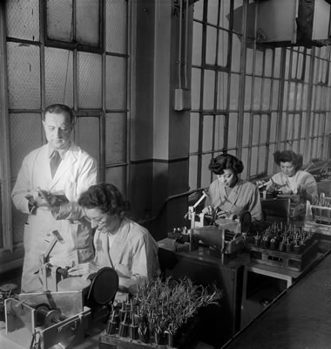
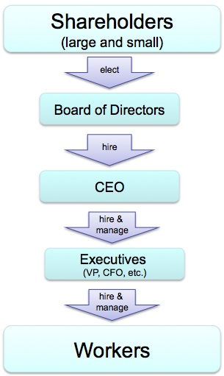
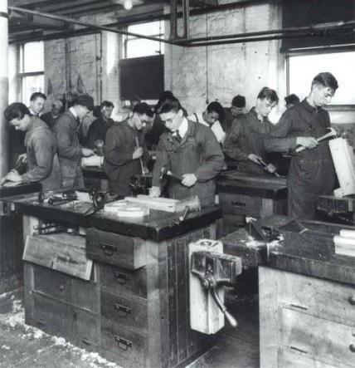
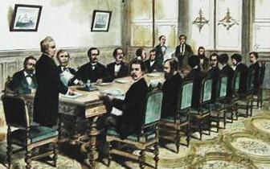
Industrialists like Vanderbilt, Carnegie, Rockefeller changed the way businesses were organized
Businesses hired professional managers to oversee employees, improve efficiency, and manage finances
Corporations became a more common business structure
Corporations used boards of trustees (“trusts”) to manage the company…
Holding Company
Board of Trustees
Company A
Company B
Company C
Company Manager
…and holding companies to manage other subsidiary companies
Employees
Company D
Company E
Employees
Company F
Employees
Company G
Employees
Company H

Slide 16
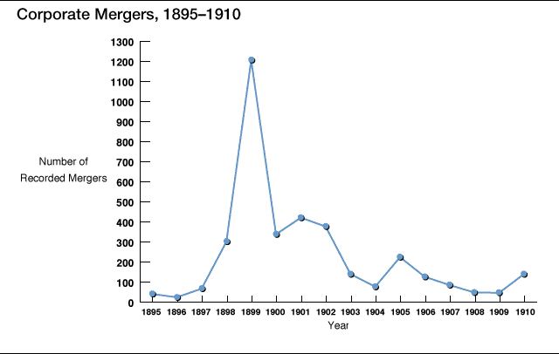
Corporations used mergers to increase profits

Slide 17
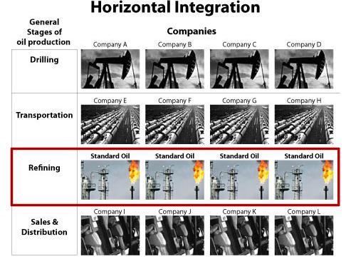
Companies like Standard Oil used horizontal integration to buy similar companies to reduce competition

Slide 18
Companies like Carnegie Steel used vertical integration to buy companies in order to gain materials needed to make or deliver their products

Slide 19
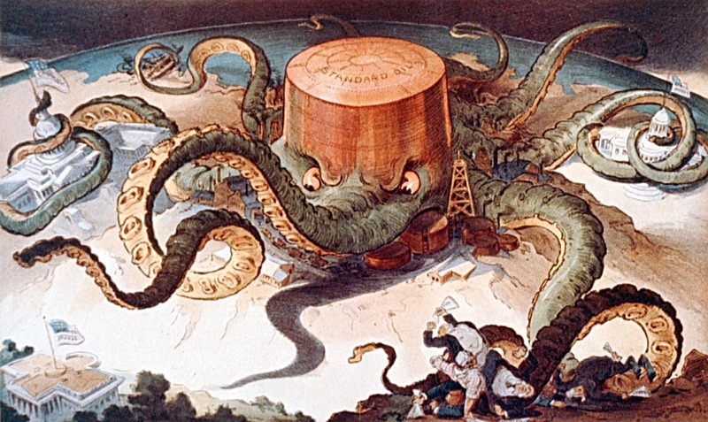
Corporate mergers led to giant companies called monopolies that controlled the majority of an industry…
Because most monopolies were run by boards of trustees, monopolies became known as “trusts”

Slide 20
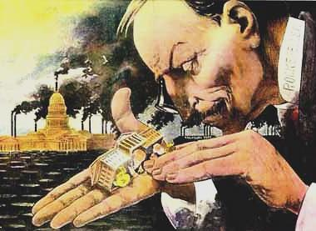
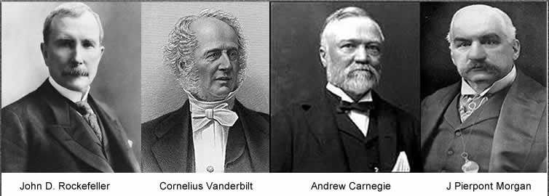
Monopolists justified their wealth in a variety of ways
The “Gospel of Wealth” argued that it is God's will for some men to gain great wealth so they could serve the public
Social Darwinism taught that natural competition weeds out the weak and allows the strong to survive
The government used laissez faire policies toward big business…
…the lack of regulation allowed businesses to become very powerful and exploitive

Slide 21
Conclusions
America was changed by the Industrial Revolution:
The United States led the world in industry, innovation, and wealth
Laissez-faire gov’t policies and new business tactics led to monopolies
But the gap between the wealthy monopolists and their poor immigrant workers grew wider

Slide 22
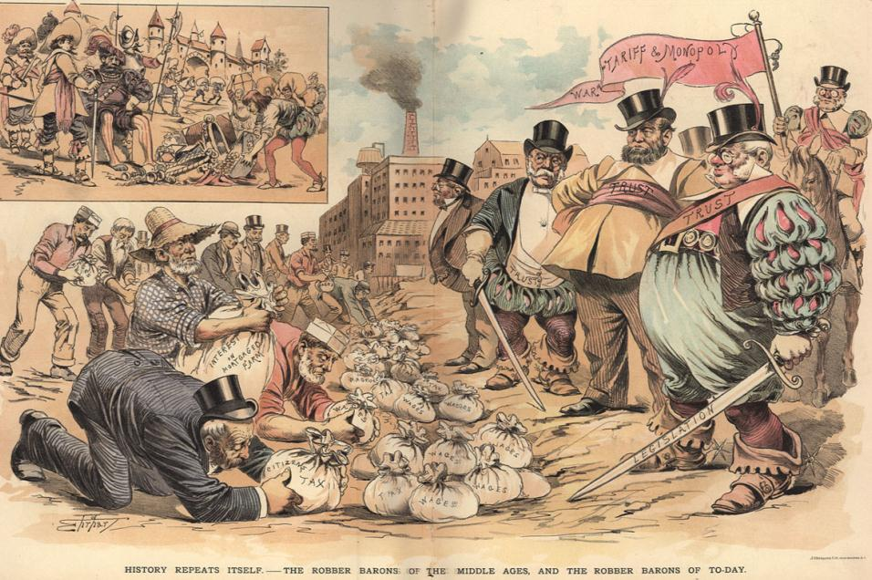
“Robber Barons” of the Gilded Age
Were the industrial capitalists of the Gilded Age “robber barons” or “captains of industry”? Weigh their positive and negative effects

